Slide 1

Innovative automation
hackathon

Slide 2

FLASH
SEARCH
WITH AI

Slide 3

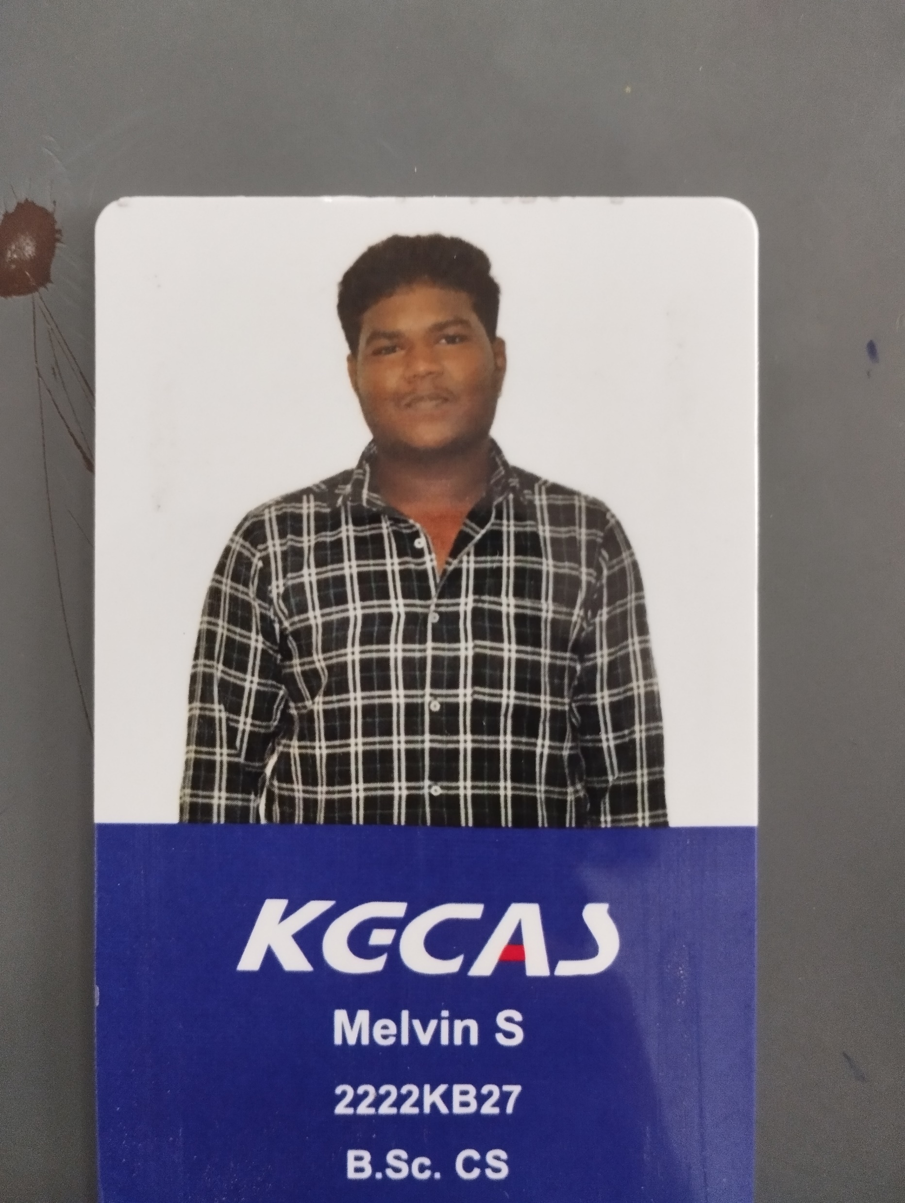
Team Slide
DHARSHAN.K
(Bsc.cs 1-B)
KGCAS
MELVIN . S
(Bsc.cs 1-B)
KGCAS

Slide 4
Problem Statement & Proposed Solution
Problem
Solution
Developed an activity in UiPath to help the people to find information in a easier manner in web .
Finding short type of information with the help of UiPath bot.

Slide 5
Benefits & Technologies Used
Details
Benefits
End-User | People in need of information
User Department | education
Industries | Technological
UiPath Products Used | UiPath Studio, UiPath Assistant and Orchestrator
Other – Integrations / APIs / Technologies Used
User could get the information much faster than the regular search
Helps to save time
We can be faster than others
When there is a regular use of searching ,this is the best way to search and to speed up our time

Slide 6
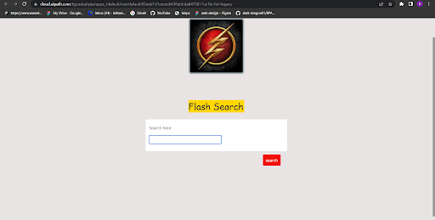
Solution Architecture
Get the input from the user to search.

Slide 7
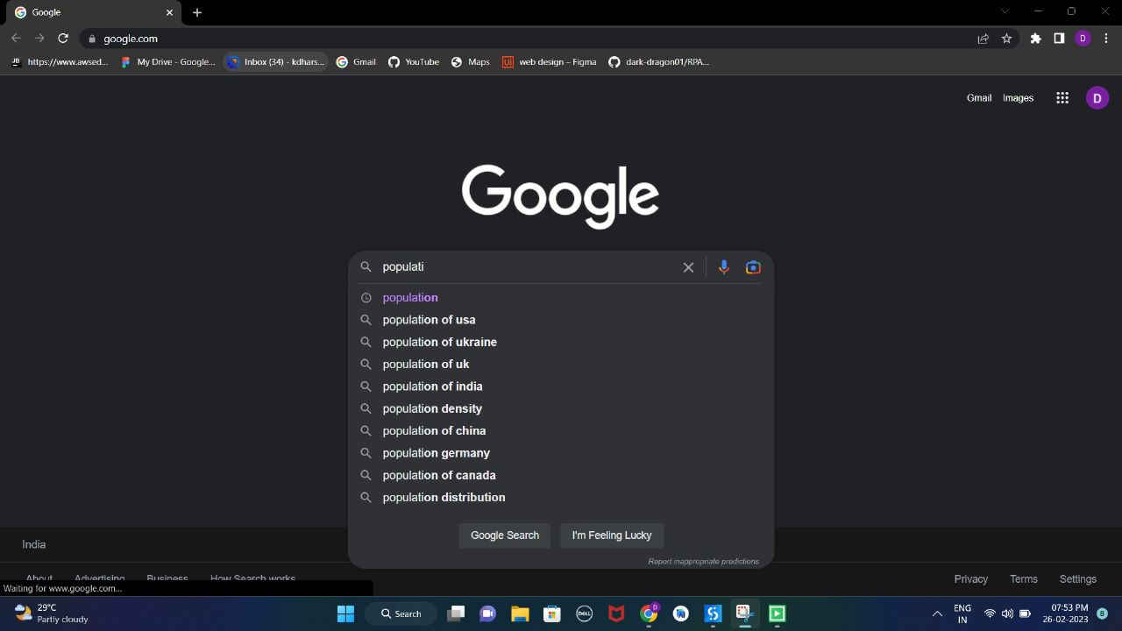
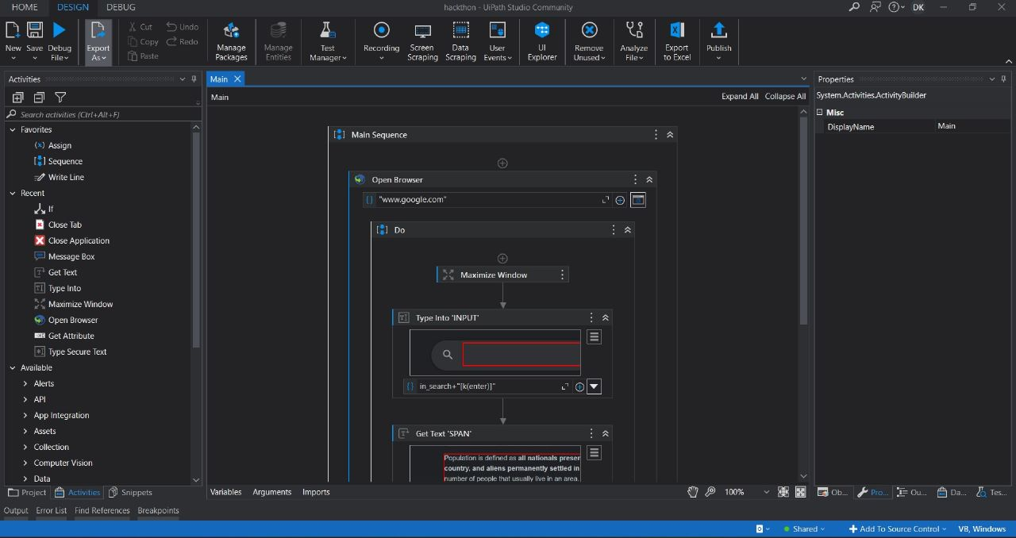
search the relevant information that the user requires from the web
This process is done with the help of UiPath Studio.

Slide 8
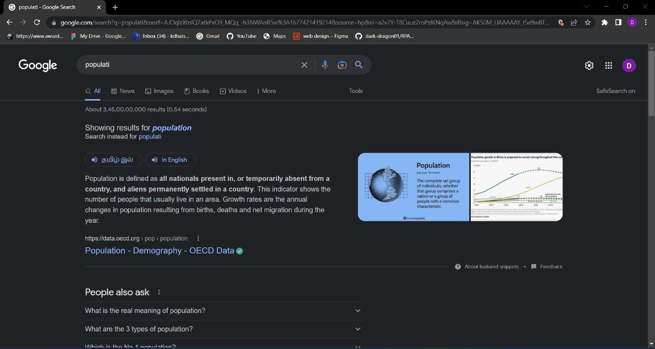
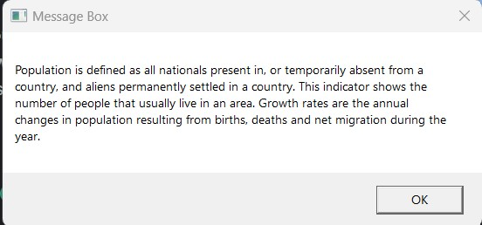
Display the result by extracting data from the Google.

Slide 9


